Slide 1
Network Topology
The topology of a network defines how the nodes of a network
are connected.
A network is defined by a physical topology and a logical topology.
Physical topology defines how the nodes of the network are
physically connected .
Logical topology dedicated connections between certain selected
source-destination pairs using the underlying physical topology.
In order to have an efficient system, the logical topology should be
chosen such that either the average hop distance or the packet
delay or the maximum flow on any link must be minimal.

Slide 2
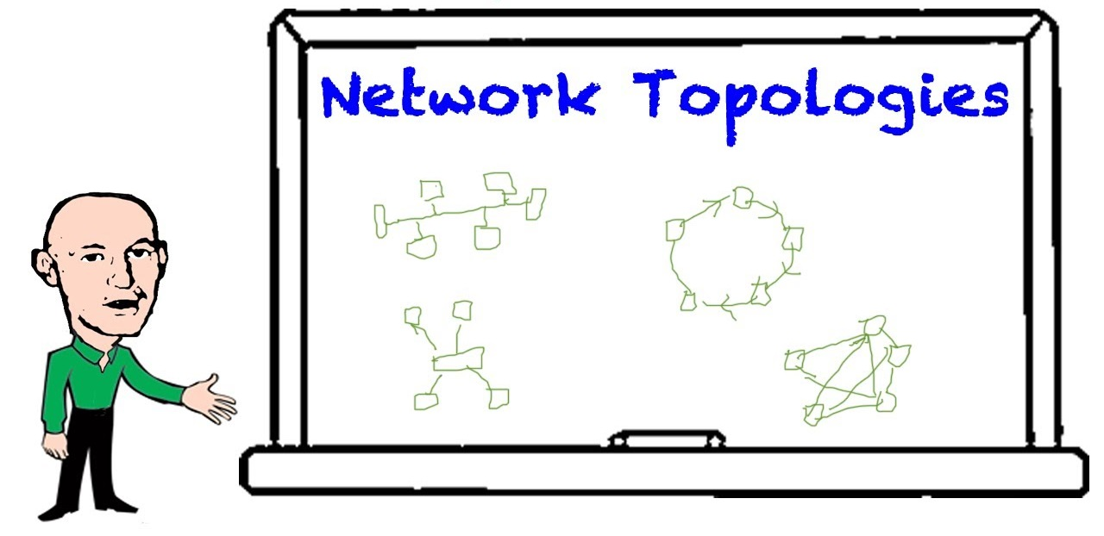
Communication Networks
Network topologies:
The Star Network
Bus Network
Ring Network
4 Star Network
5 Hybrid Topology
6 Tree Topology

Slide 3
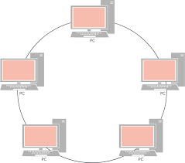
Star Topology
-A ring network is a network topology in which each node connects to exactly two other nodes, forming a single continuous pathway for signals through each node - a ring.
-Data travels from node to node, with each node along the way handling every packet.

Slide 4
A bus network topology
Use: This topology is useful
in LANs. It does not rely on
central host.This network can
still function if one of the
computers malfunctions.
Other advantages: easy to
wire, quick response, less
expensive
C 1
C 2
C 3
C 5
C 6
C 4
Problem: The main disadvantage is bad connection to the cable can bring down the entire network. Another problem: collision occurs when 2 nodes send messages simultaneously.

Slide 5
A ring network topology
This topology is useful
in LANs. It does not rely on
central host.This network can
still function if one of the
computers malfunctions.
C 1
C 6
C 2
Host
The connecting wire, cable,
or optical fiber forms a closed
loop. Data are passed along the
ring from one computer to
another.
C 3
C 5
C 4

Slide 6
A star network topology
Use: This topology is
useful for applications
where processing must
be centralized and some
can be performed locally.
C 1
C 6
C 2
Host
CPU
Problems:
All communication pass
through the central computer.
The communications in the
network will stop if the host
computer stops functioning.
C 3
C 5
C 4

Slide 7
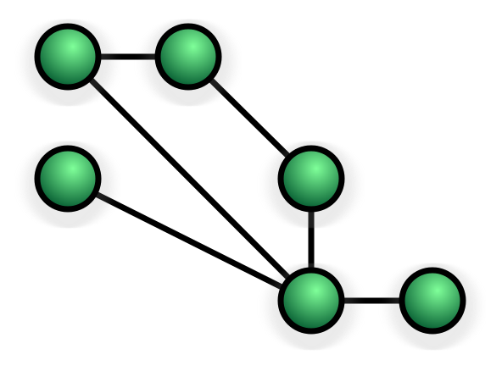
Hybrid Topology
Hybrid networks combine two or more topologies in such a way that the resulting network does not exhibit one of the standard topologies. For example, a tree network (or star-bus network) is a hybrid topology in which star networks are interconnected via bus networks. However, a tree network connected to another tree network is still topologically a tree network, not a distinct network type. A hybrid topology is always produced when two different basic network topologies are connected.

Slide 8
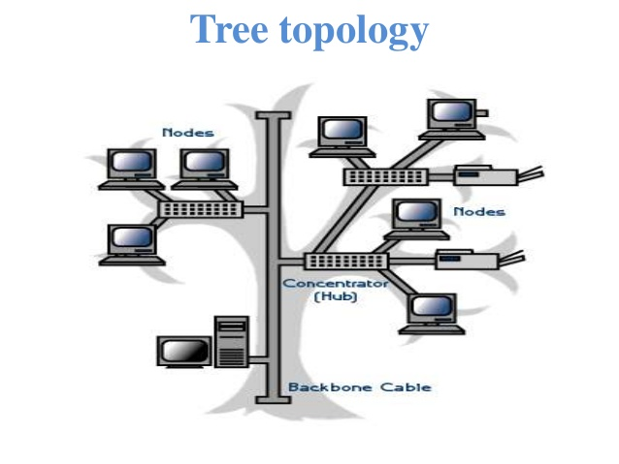
Tree Topology
A tree topology combines characteristics of linear bus and star topologies. It consists of groups of star-configured workstations connected to a linear bus backbone cable. Tree topologies allow for the expansion of an existing network, and enable schools to configure a network to meet their needs

